Slide 1
Dhaka University of Engineering and Technology, Gazipur
Dept. of Computer Science and Engineering
1
PRESENTATION ABOUT OBJECT ORIENTED PROGRAMING FINAL PROJECT ON
“Library Management System”
Presented To
Mr. Md.Omor Farque
Associate Professor, CSE
Mss. Sabah Binte Noor
Assistant Professor, CSE
Presented By
Mehedi Hasan Shuvo
Std-ID: 194016
CSE 2/1

Slide 2
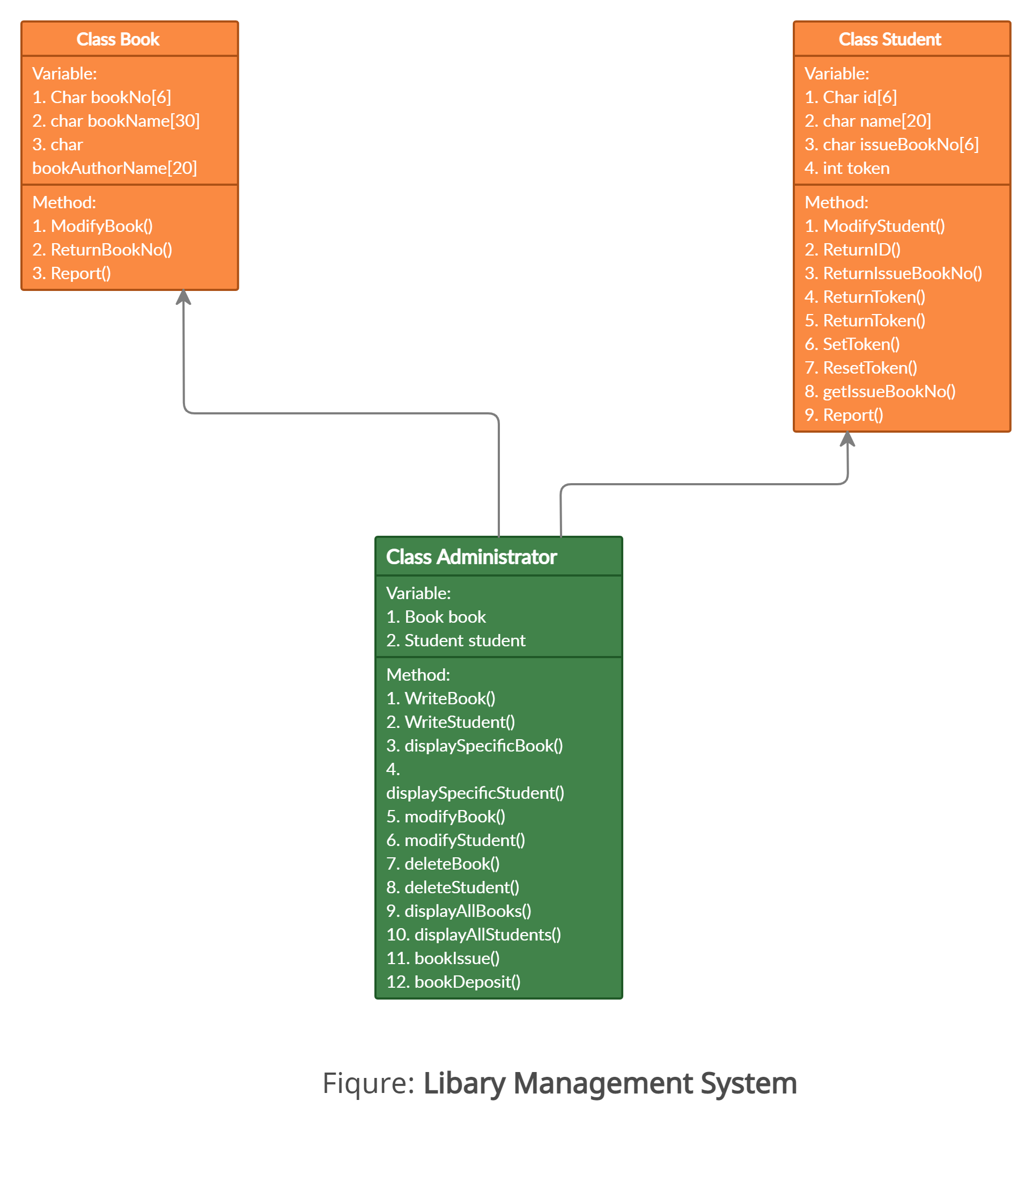
2
Project Diagram:

Slide 3

Library Management System ID: 194016
CLASS USED IN PROJECT:
3
Book
Student
Administrator
Fig: Library Management System

Slide 4
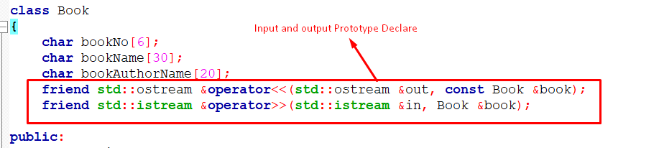
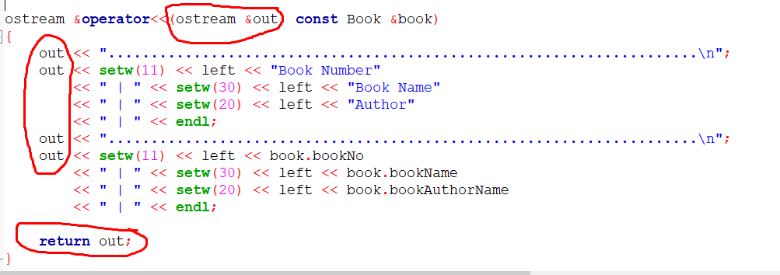
Operator Overloading IN PROJECT:
4

Slide 5
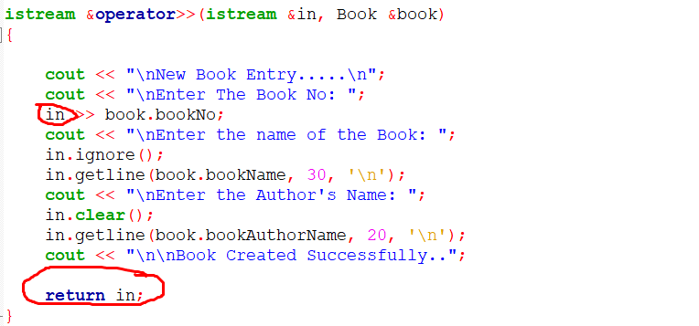
Library Management System ID: 194016
Operator Overloading IN PROJECT:
5

Slide 6
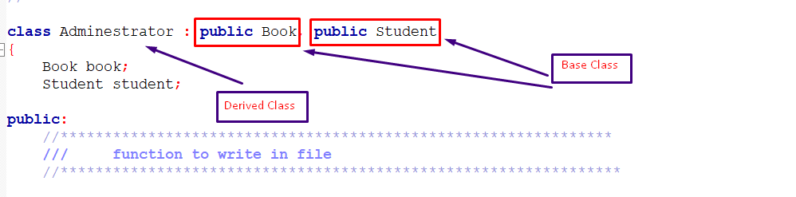

Library Management System ID: 194016
Inheritance Used In Project:
6
File Declare In Project:
File Name:
student.dat
Book.dat
Temp.dat

Slide 7
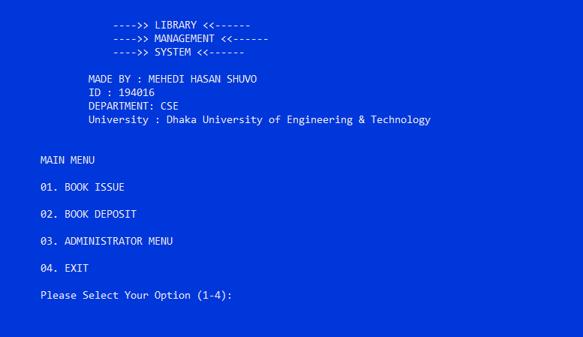
Project Output Sample:
7
When Start Project:

Slide 8

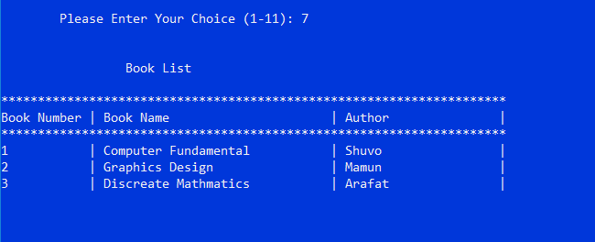
Display View All Students:
8
Display View All Books:

Slide 9
Acknowledgement
9
Thanks to the honorable Teachers and all of the website resources used in this presentation.

Slide 10
10
Thank you

